Slide 1
Overview of Linux

Slide 2
Agenda
What is Linux
Linux Flavours
Package Management – RPM & YUM
Overview of Linux Filesystem
Important Linux Commands

Slide 3


What is Linux?
A widely used Open Source Unix-like operating system.
Linux was first released by its inventor Linus Torvalds in 1991.
The inner workings of Linux are open and available for anyone to examine and change as long as they make their changes available to the public.
The Linux kernel is central to the Linux computer operating system. The kernel is the core interface between a computer's hardware and its processes, making sure there is available memory for Linux applications to run, optimizing processors, and navigating system requirements across applications.
Linux file names are. For example "abc" and "aBC" are different files in Linux,

Slide 4



Some Linux Flavours
Red Hat Enterprise Linux (RHEL) is a Linux-based operating system developed by Red Hat and targeted toward the commercial market. Red Hat Enterprise Linux is released in server versions for x86, x86-64, Itanium, PowerPC and IBM System z, and desktop versions for x86 and x86-64.. Red Hat Enterprise Linux is often abbreviated to RHEL.
CentOS (Community Enterprise Operating System) is a Linux distribution which attempts to provide a free enterprise class computing platform which has 100% binary compatibility with its upstream source, Red Hat Enterprise Linux (RHEL).
Fedora is an RPM-based operating system based on the Linux kernel, developed by the community-supported Fedora Project and owned by Red Hat.

Slide 5
Package Management
Two types of utilities to install packages: RPM and YUM.
RPM- RPM Package Manager
It is an open packaging system available for anyone to use
It also maintains a database of all packages and their files that can be used for verifying packages and querying for information about files and/or packages
RPM packages typically have file names like foo-1.0- i386.rpm. The file name includes the package name (foo), version (1.0), release (1), and architecture (i386).
It can be used to build, install, query, verify, update, and remove/erase individual software packages.

Slide 6
RPM COMMAND SHEET
Command | Description | Example
rpm -ivh {rpm-file} | Install the package | rpm -ivh --test mozilla-mail-1.7.5- 17.i586.rpm
rpm -Uvh {rpm- file} | Upgrade package | rpm -Uvh mozilla- mail-1.7.6- 12.i586.rpm
rpm –Fvh {rpm- file} | Freshen the Package | rpm -Fvh mozilla- mail-1.7.6- 12.i586.rpm
rpm –e {package} | Erase/remove/ an installed package | rpm –e mozilla- mail-1.7.6- 12.i586.rpm
rpm -qa | Display list all installed packages | rpm –qa ,rpm -qa | less
12/30/09

Slide 7
YUM
Yellowdog Update, Modified (YUM) is a package manager that was developed by Duke University to improve the installation of RPMs.
No mount is required.
It will show information about installed and non- installed packages
YUM installs the required dependencies automatically
For using YUM you need to create repositories (On-Premises)
12/30/09

Slide 8
YUM COMMAND SHEET
Command | Desciption | Example
yum install {package- name-1} | Installs the Package | yum install httpd
yum update {package-name-1} | Updates the Package | yum update httpd
yum list installed | List all installed packages
yum list {package- name} | List a particular package | yum list httpd
yum list all | Lists all the packages
yum remove {package-name-1} | Removes package | yum remove httpd
12/30/09

Slide 9
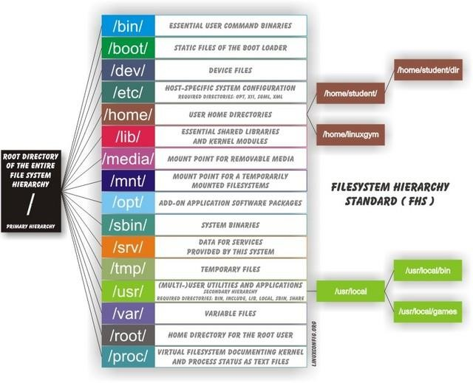
FILESYETEM HIERACHY
13

Slide 10
Important Linux Commands
Moving around in the file system
Command | Action
pwd | "Print working directory" - show what dir you're in.
ls | List the contents of a dir.
ls -l | List the contents of a dir and show additional info of the files.
ls -a | List all files, including hidden files
cd | Change directory.
cd .. | Go to the parent directory.
Examining files
file | Determine the type of a file.
cat | Displays the contents of the file.
less and more | View text files and paginate them if needed.
head | Displays first 10 records of file
tail | Displays last 10 records of file
Manipulating files and directories
cp | Copy a file.
mv | Move or rename a file.
rm | Remove a file
mkdir | Make a directory.
12_{r}/_{m}30_{d}/0_{ir}9 | Remove an empty directory.

Slide 11
Important Linux Commands
Moving around in the file system
Command | Action
File Compression
gzip | Compress the file
gunzip | Uncompress the file
tar | Archive mutiple files without compression
Disks and Filesystems
df | Show free disk space
du | Reports the sizes of directories
mount | Make a disk accessible
umount | Makes a disk inaaccessible
12/30/09

Slide 12
Important Linux Commands
User Management
Command | Action
id | Print real and effective user id and group ids.
w | Display users logged in and what they are doing.
who | Display the users logged in.
whoami | Print effective user id.
useradd | Create a new user or update default new user information.
userdel | Delete a user account and related files.
usermod | Modify a user account.
groupadd | Create a new group.
groupdel | Delete a group
Groupmod | Modify a group
groups | Print the groups a user is in
passwd | Set a user's pass word.
su - username su - | Switching to user and root.
finger | See what users are running on a system.
chown | Change the owner of file(s ) to another user.
chgrp | Changes the group ownership of files.
12/3/09

Slide 13
Q & A

